Slide 1

E.G.S.PILLAY ENGINEERING COLLEGE NAGAPATTINAM

Slide 2
CLOUD FILE STORING SYSTEM
ACADEMIC PROJECT: PHASE I
MINI PROJECT REVIEW

Slide 3
ABSTRACT
The Cloud file storing is the web real-time applications technology that will easily Upload the file between Computer over the internet To cloud file storing or mobile device easily…….

Slide 4
PROBLEM DEFINITION
The Cloud file storing project was useful for the business, college students etc..
So we don’t need any pen drive,SSD,Hard drive for copy file computer to free up the computer space also so free up the mobile storage space real

Slide 5
OVERVIEW
User
Signup : user can signup access full control of the website client access the file sharing Login :user can login using thar username and id
Dashboard : the dashboard contain the send option recive option

Slide 6
OVERVIEW
Send option : the send option was upload and send the file to the client
Receive option : the revive option was one key was put in the receive option that was show that file we can download that file easily

Slide 7
OVERVIEW
About us :User sees the details of .website administrator
Contat us :User can contact with website
administrator.

Slide 8
HARDWARE REQUIREMENTS
System : i3‑7020U Processor
Hard Disk : min 100mb to max 2tb
Monitor : 1080p monitor
Ram : 1gb

Slide 9
SOFTWARE REQUIREMENTS
Operating system : Linux ubuntu
Coding Language : CSS, HTML, JS
Software Requirement : nginx server, nano text editor

Slide 10
FRONT END
1)HTML
2)CSS
3)JAVA SCRIPT

Slide 11
BACK END
1)PHP
2)MYSQL

Slide 12
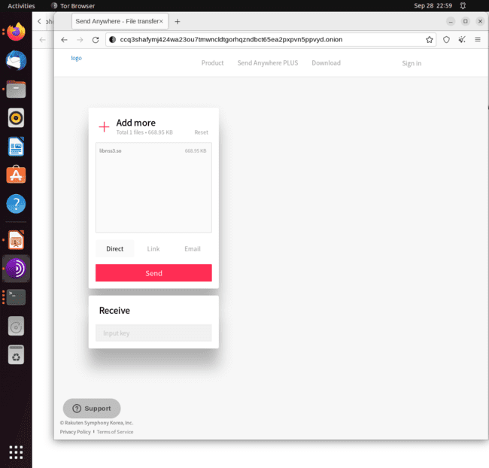
SCREEN SHOTS

Slide 13
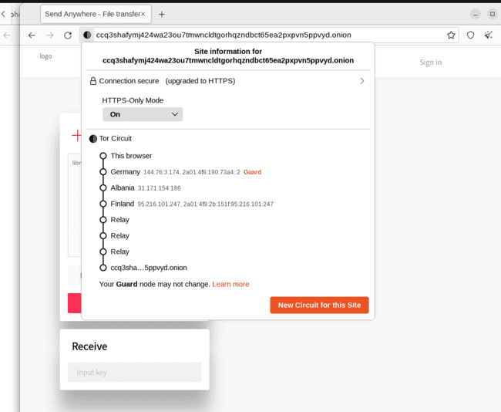

Slide 14
THANK YOU …...

